Slide 1
Prepositions
How many can you add to these pictures?

Slide 2
Teaching Ideas: Prepositions
Thanks for your download! The purposes of this activity are to:
  Engage prior knowledge.
  Show students they already have a grasp on grammar.
  Work on a variety of prepositions.
  Have fun.
After introducing prepositions, show one or two of these slides per day. You could also assign a slide to groups of students and ask them to think of the prepositional phrases.
I often keep a list of prepositions next to me as students list them. Then, I mark out prepositions as we talk.
I have not included an answer key. Sample prepositions for the first slide (the graduates) include: caps in the air, caps on heads, sky above graduates, school behind them, excitement ahead of them, promise before them, ties around necks, graduation during the day
Students often want to use “to” and a verb form (an infinitive) as prepositions, like “to graduate.” I remind them that a preposition needs an object, not a verb form.

Slide 3


Slide 4


Slide 5
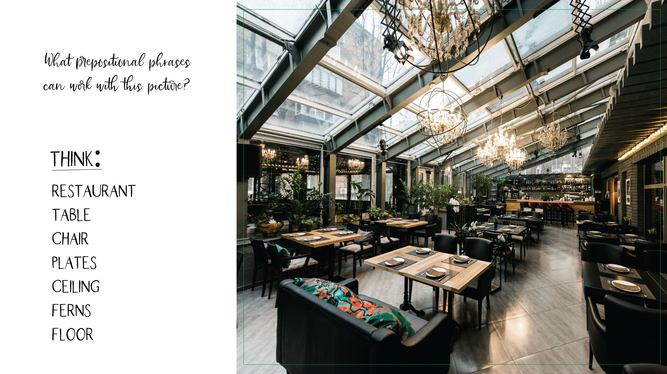

Slide 6
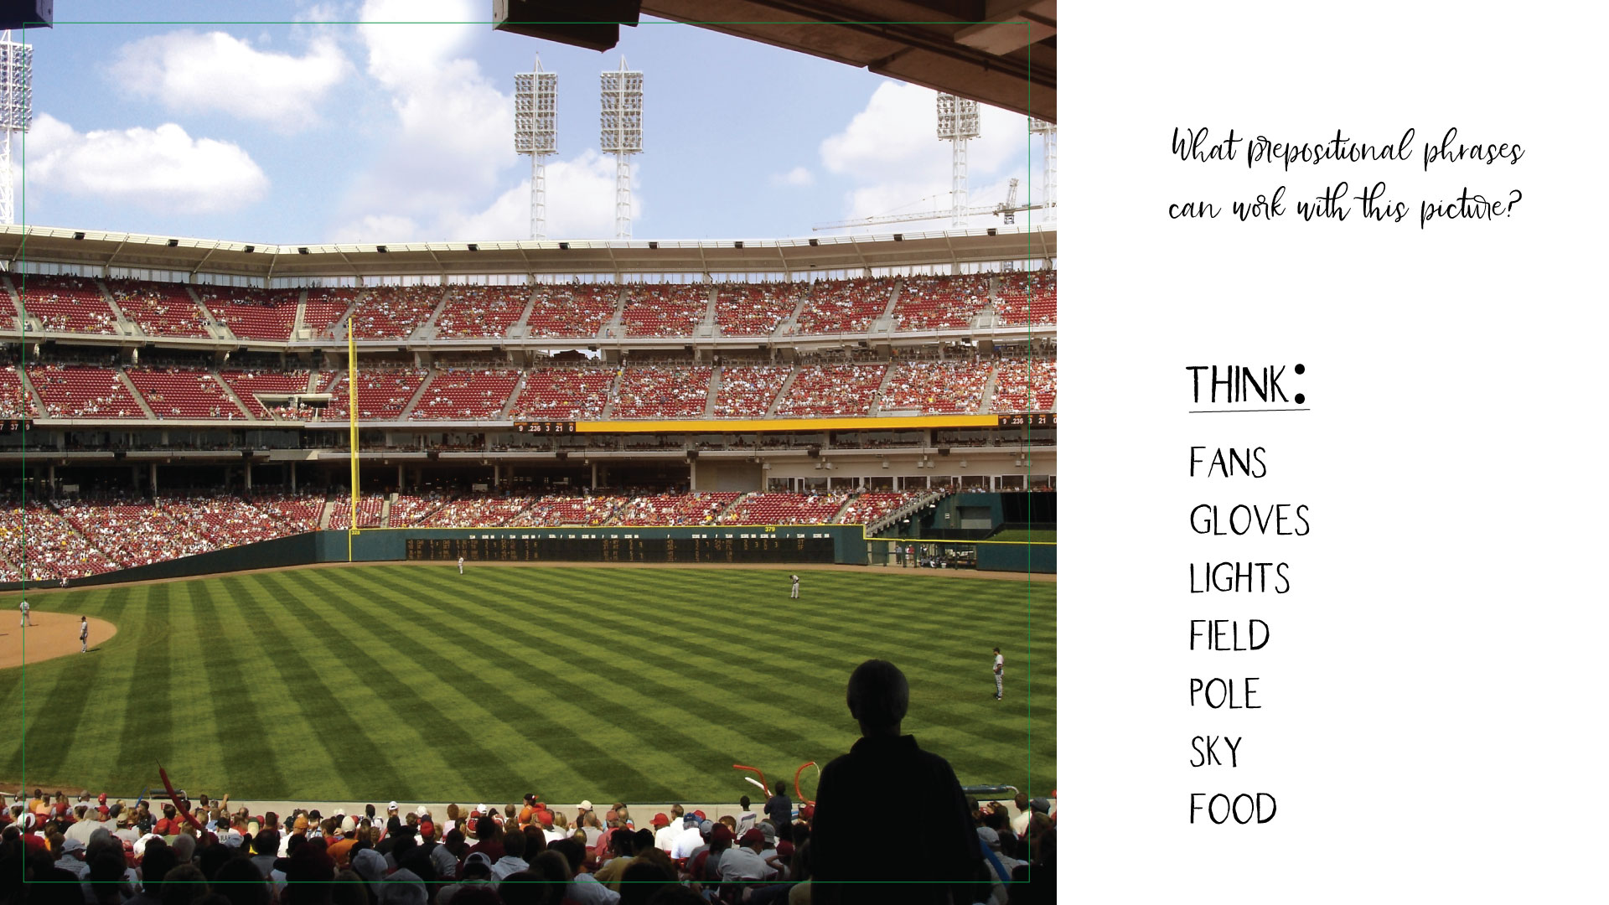

Slide 7
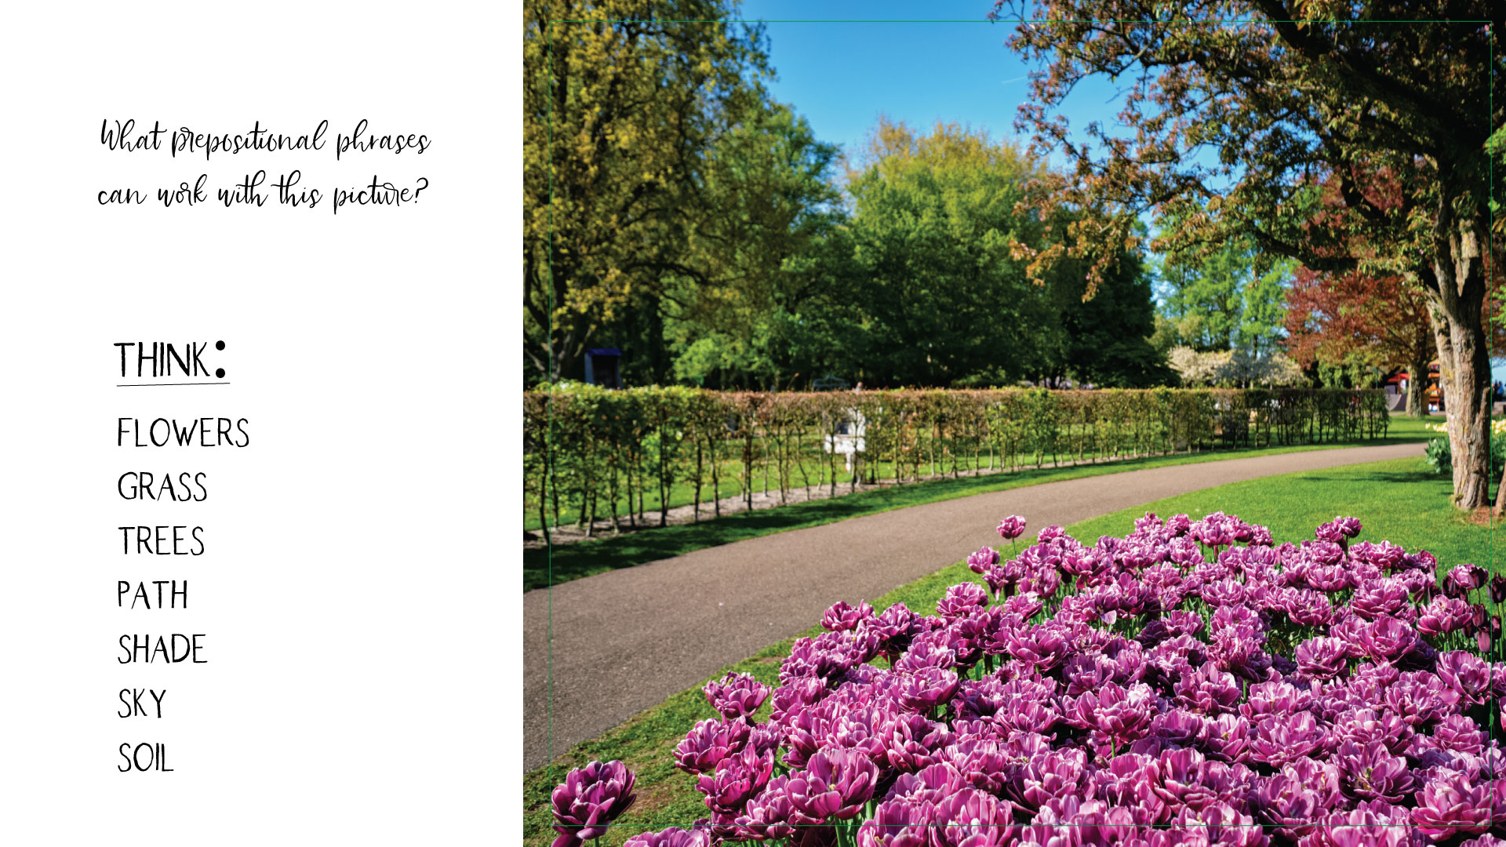

Slide 8
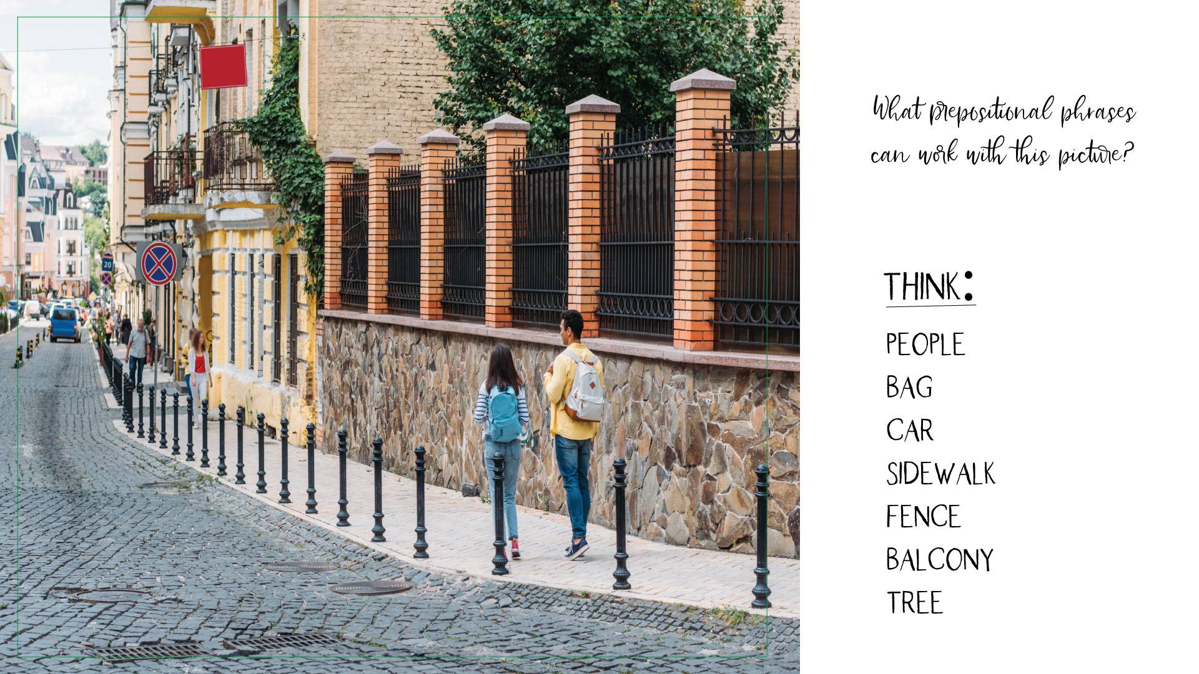

Slide 9
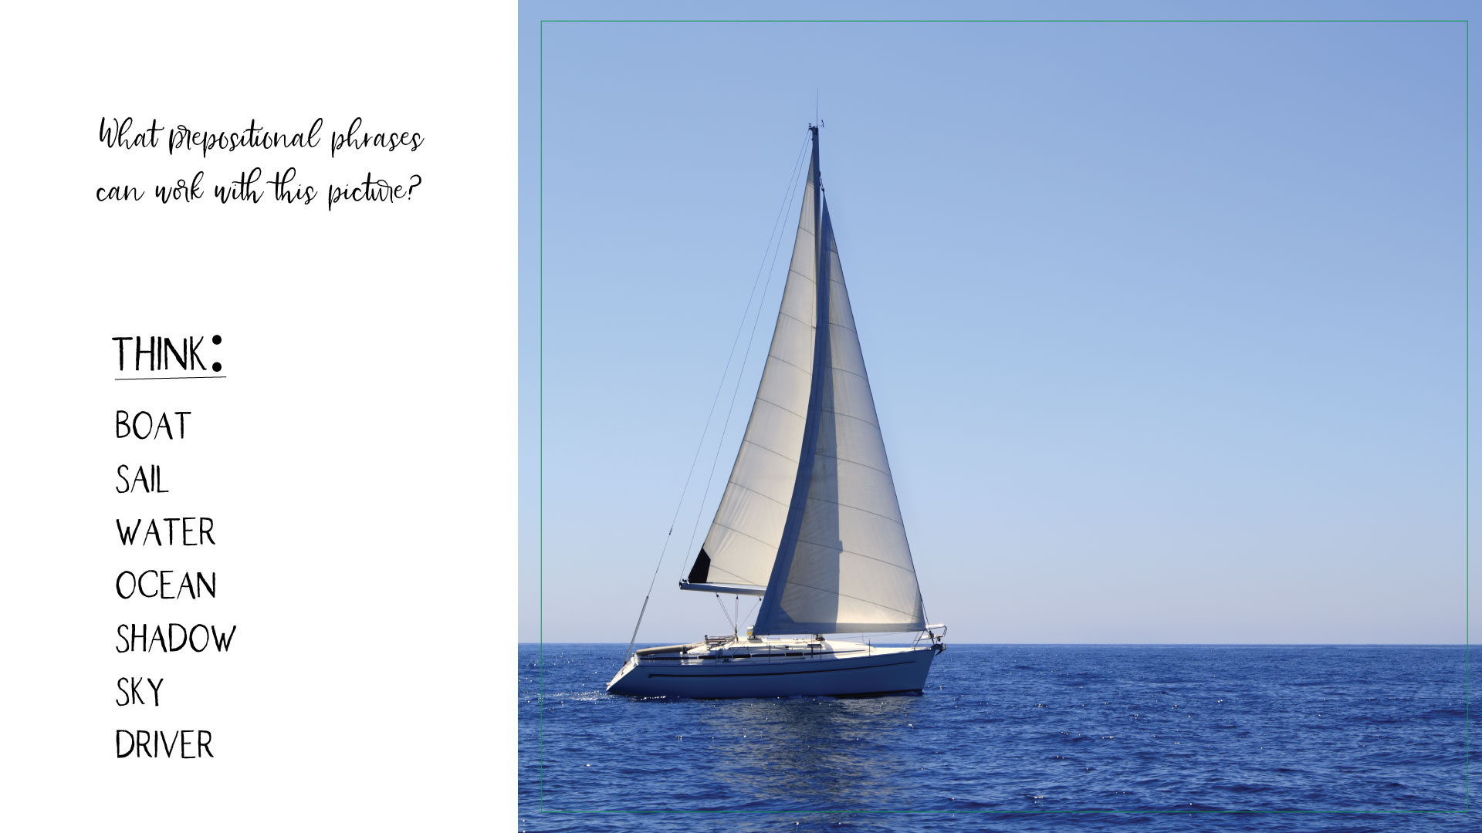

Slide 10
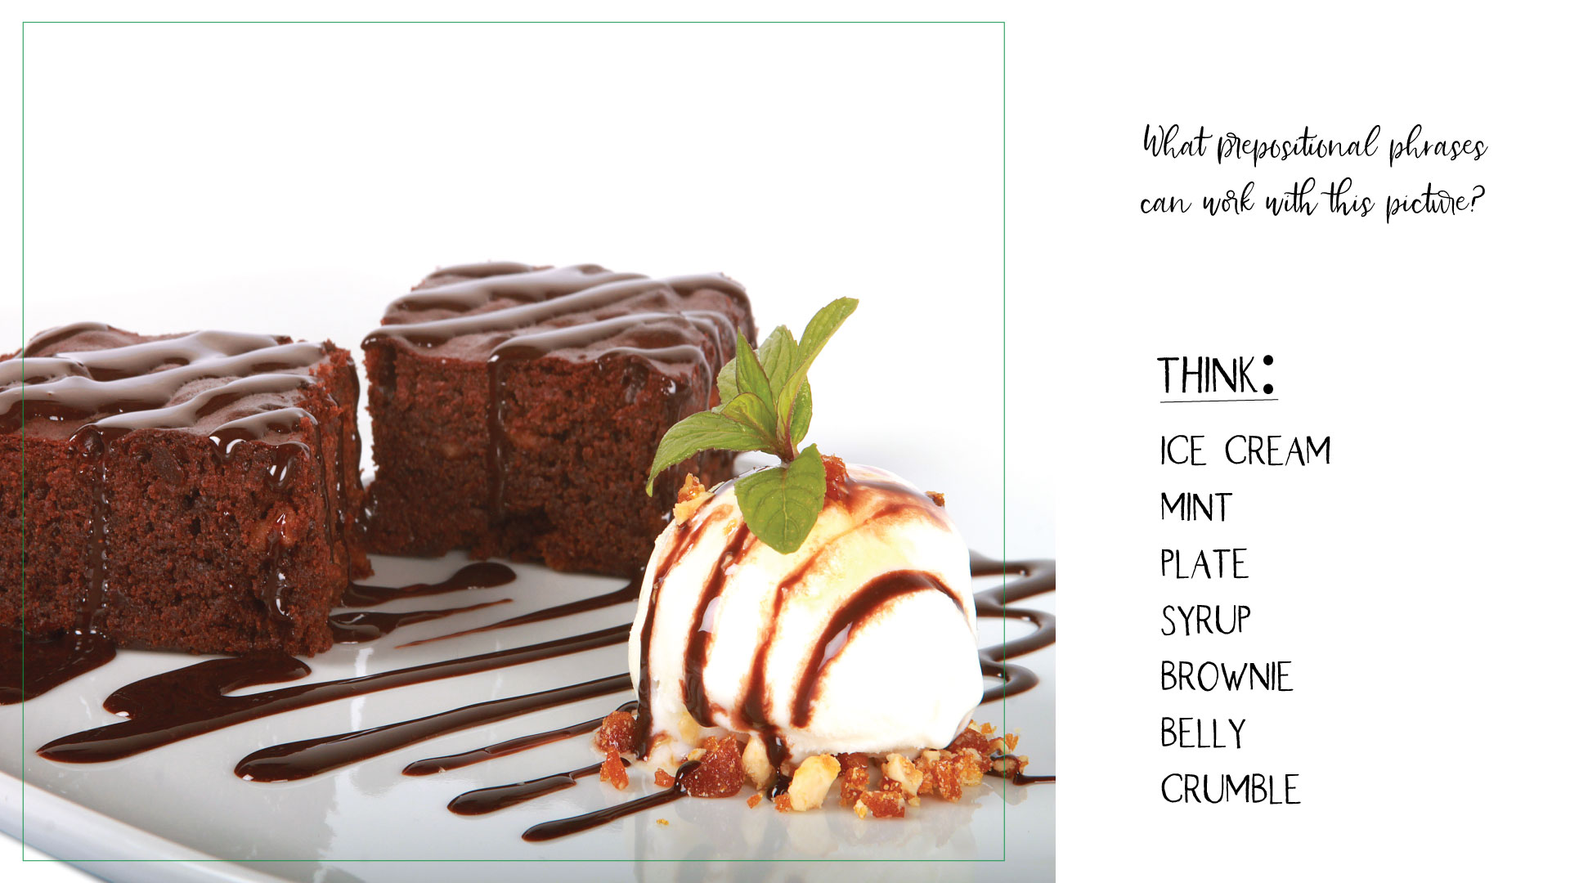

Slide 11
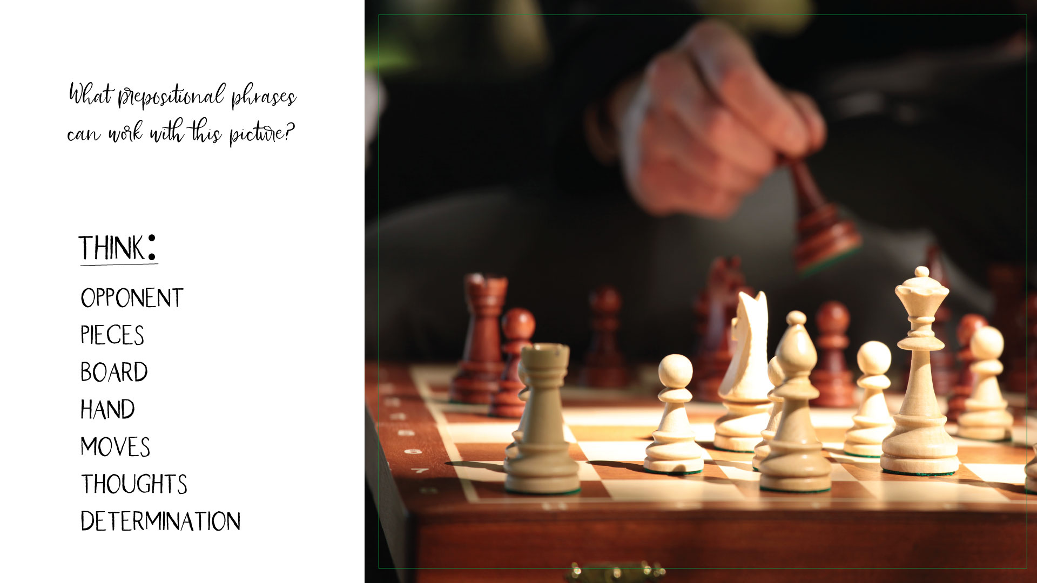

Slide 12
