Slide 1
Grammar Stations Editable Pages
from Language Arts Classroom
To use:
Go to “insert.”
Click “text box.”
Type your specific directions or guidelines in the box.

Slide 2
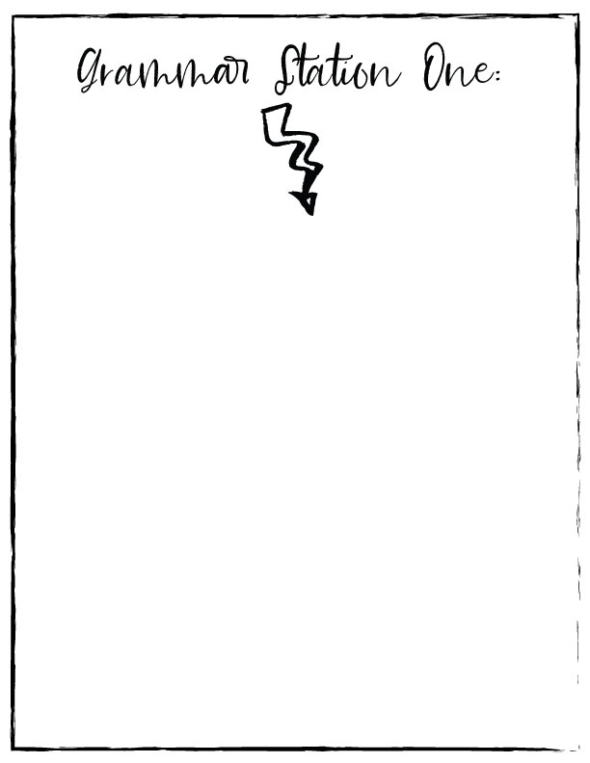

Slide 3
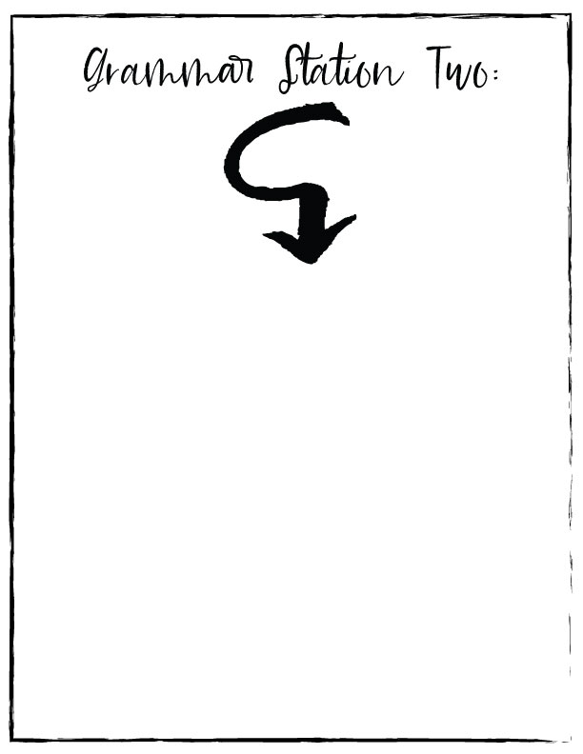

Slide 4
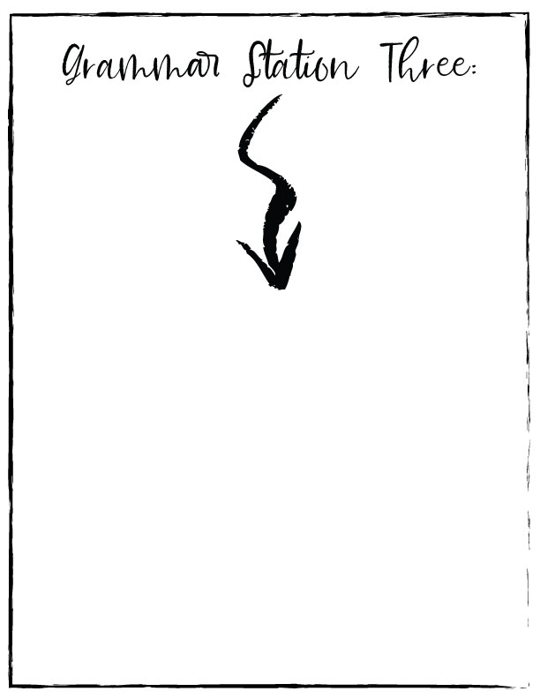

Slide 8
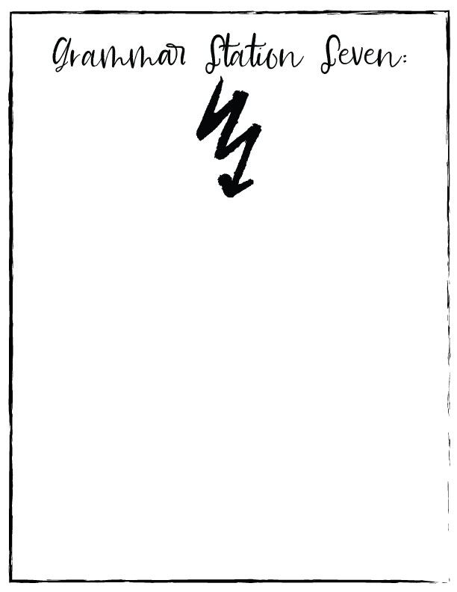

Slide 9
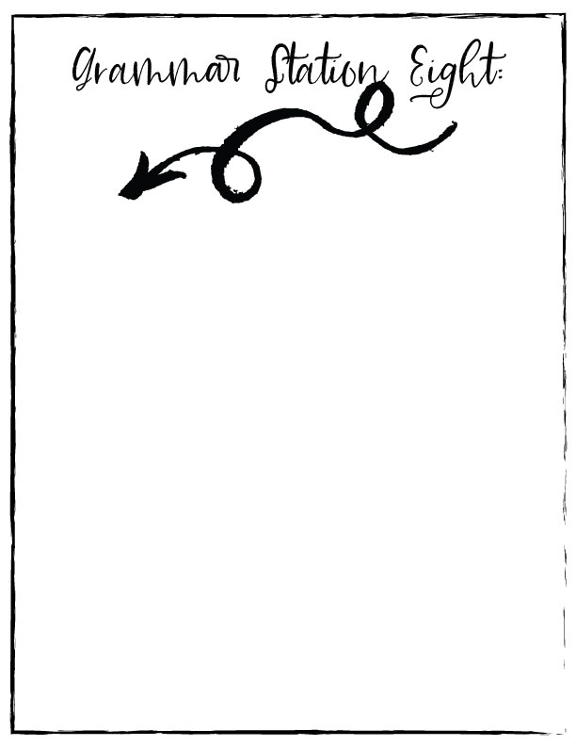

Slide 10
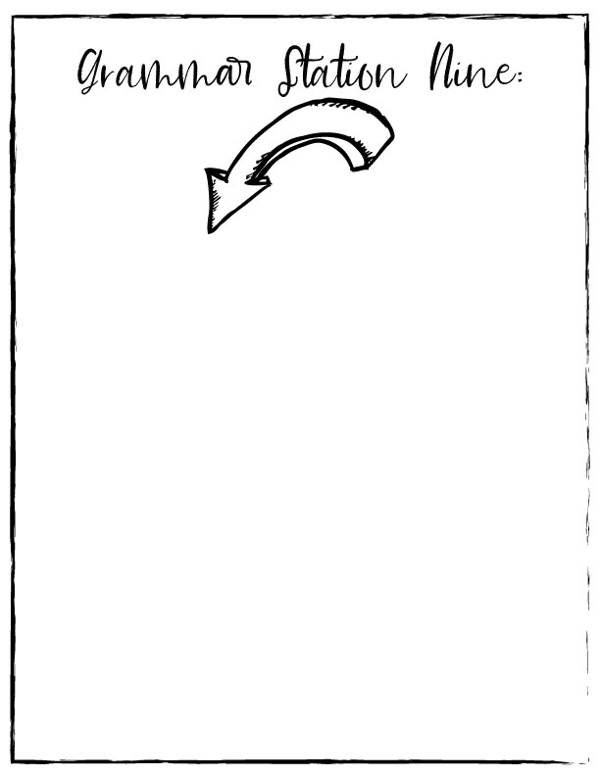

Slide 11
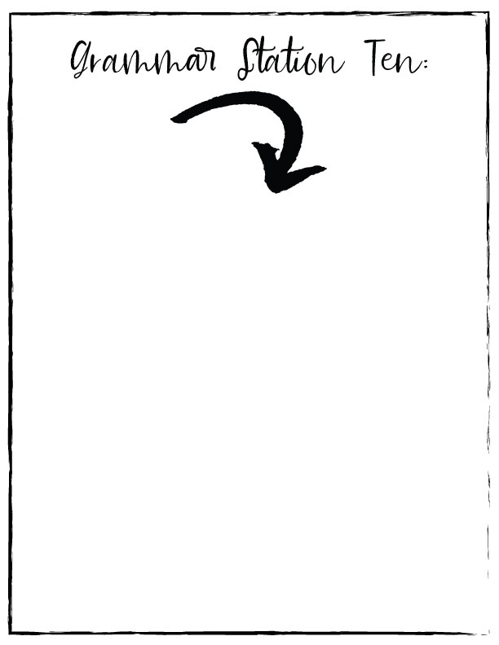

Slide 13
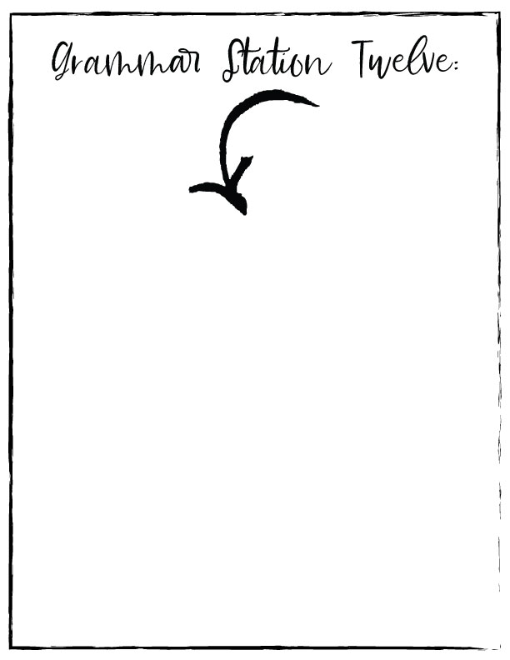

Slide 14
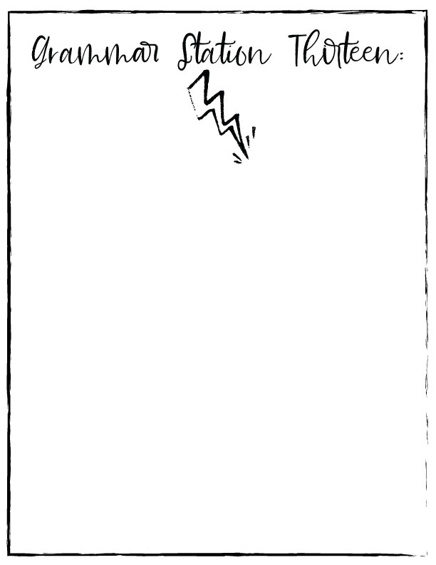

Slide 17
Looking for premade grammar stations? Try these varieties:

